Slide 1



Department of Computer Science and Engineering
NETWORK INTRUSION DETECTION SYSTEM ANLYTICS USING MEMORY BASED LEARNING APPROACHES
Team Members Name Register Number
Jenish Rojin S 211420104111
Kesavaraman M R 211420104131
Lingesh P 211420104147
Mr. A N Sasikumar
Dr. G Senthil Kumar
Guide Name & Designation
Coordinator Name & Designation

Slide 2
Introduction
Network Intrusion Detection Systems (NIDS) play a critical role in protecting computer networks from various security threats and attacks.
As the complexity and frequency of network attacks continue to evolve, there is a growing need for advanced analytics techniques to enhance the detection and response capabilities of NIDS
The goal is to leverage these techniques to improve the accuracy, efficiency, and effectiveness of NIDS in identifying and mitigating security breaches.

Slide 3
Objective of the Project
The objective of the project is to building an Intrusion Prevention System (IPS) that actively safeguards network security.
This IPS achieves its goal by dropping malicious packets, blocking problematic IP addresses, and alerting security personnel about potential threats.
It relies on a signature database for recognizing known attack patterns and can also identify anomalies in network traffic.
This holistic approach enhances network security by preventing attacks and swiftly responding to emerging threats

Slide 4
Literature Survey
Year | Author | Title | Methodology | Issues
2023 | Md. Alamin Talukdera , Khondokar Fida Hasanb , Md. Manowarul Islama | A Dependable Hybrid Machine Learning Model for Network Intrusion Detection | Hybrid Model Construction | Imbalanced Data, Resource Constraints
2018 | Saddam Hossen, Anirudh Janagam | Analysis of Network Intrusion Detection System with Machine Learning Algorithms | Data Preprocessing and Feature Selection | Evolving Threats

Slide 5
Existing System
Enhancing Network Intrusion Detection Systems (NIDS) with supervised Machine Learning (ML) is tough. ML-NIDS must be trained and evaluated, operations requiring data where malicious samples are clearly labelled.
Such labels demand costly expert knowledge, resulting in a lack of real deployments, as well as on papers always relying on the same outdated data.
However, most past works used such datasets just as a ‘yet another’ test bed, overlooking the added potential provided by such availability.
Despite many successes, the integration of supervised Machine Learning (ML) methods in Network Intrusion Detection Systems (NIDS) is still at an early stage.
This is due to the difficulty in obtaining comprehensive sets of labelled data for training and evaluating an ML-NIDS.
Demerits
They are not predicting the classification of attack types.
They are not mentioning the accuracy.
They are using machine learning technique only for analysing purpose.

Slide 6
Proposed System
In the proposed system, we aim to enhance the effectiveness and efficiency of network intrusion detection systems (NIDS) by incorporating machine learning techniques into the analytics process.
This system offers several benefits, including improved detection accuracy, proactive threat identification, and adaptability to evolving intrusion patterns.
By using machine learning techniques, the system can effectively analyse large volumes of network traffic data and identify subtle indicators of intrusions that may go unnoticed by traditional rule-based approaches.
The proposed system can be designed to continuously update and adapt the machine learning models as new network data becomes available.
This allows the system to capture evolving intrusion patterns and improve its detection capabilities over time.
By leveraging the power of machine learning, the system can improve the accuracy, efficiency, and effectiveness of intrusion detection, ultimately enhancing the security posture of computer networks.

Slide 7
Merits
We build a production level application for deployment purposes.
We use a machine learning techniques for build predictive model.
Improved accuracy and performance level.

Slide 8
Software / Hardware used
Software Requirements:
Operating System : Windows 10 or later
Tool : Anaconda with Jupyter Notebook
Language : Python
Hardware requirements:
Processor : Intel i3
Hard disk : Minimum 10 GB
RAM : Minimum 4 GB

Slide 9
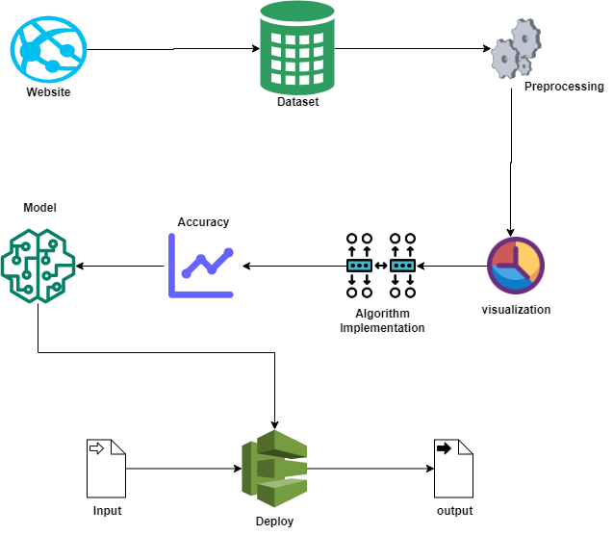
Architecture / Methodology used

Slide 10
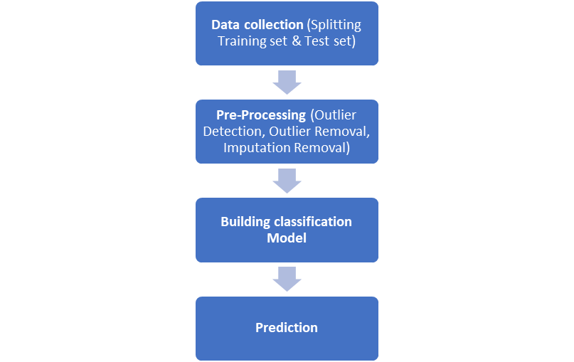
System Implementation

Slide 11
Conclusion & Discussion
In conclusion, this project has successfully addressed the objective of developing an effective Intrusion Detection System (IDS) utilizing learning-based approaches for monitoring network activities.
Through the implementation of this system, the capability to promptly detect suspicious or potentially malicious actions within the network has been significantly enhanced, providing security operations center (SOC) analysts and incident responders with early alerts for proactive threat mitigation.
Moving forward, future work could focus on several avenues for improvement. Firstly, refining the machine learning algorithms used in the IDS to enhance accuracy and reduce false positives will be crucial.
Additionally, expanding the scope of the IDS to cover a broader range of network protocols and behaviors could further strengthen its effectiveness

Slide 12



Screenshots
Login and Register Page

Slide 13
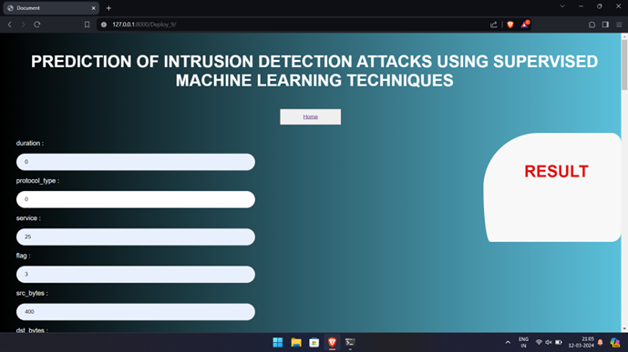

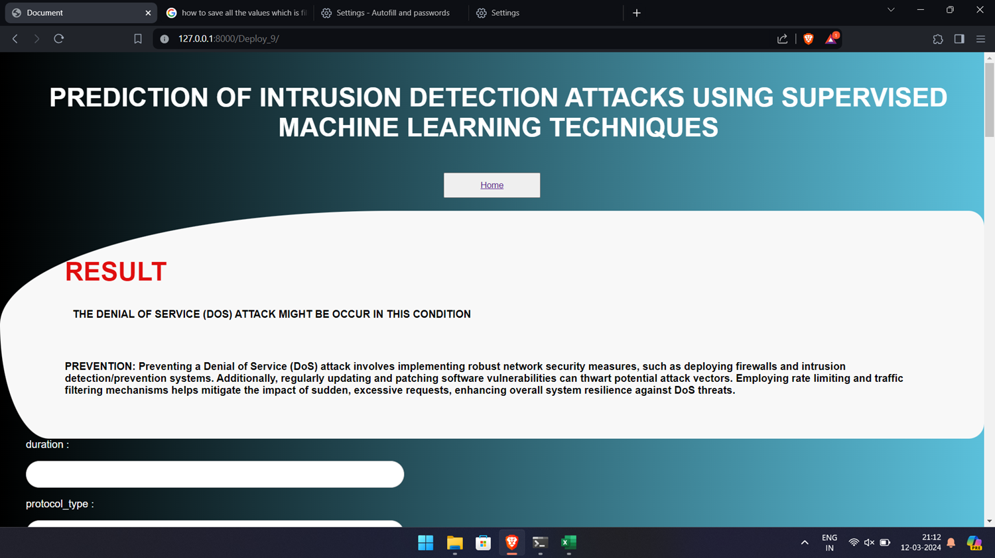
Prediction Values and Output

Slide 14
Reference Paper/ URL
Md. Alamin Talukdera, Khondokar Fida Hasanb, Md. Manowarul Islama, Md Ashraf Uddina, Arnisha Akhtera, Mohammad Abu Yousufc, Fares Alharbid, Mohammad Ali Moni. “A Dependable Hybrid Machine Learning Model for Network Intrusion Detection” - 2023
Vanlalruata Hnamte, Jamal Hussain ,” DCNNBiLSTM: An Efficient Hybrid Deep Learning-Based Intrusion Detection System”. - 2023
Saddam Hossen, Anirudh Janagam “Analysis of Network Intrusion Detection System with Machine Learning Algorithms (Deep Reinforcement Learning Algorithm)” - 2018
Zeeshan Ahmad, Adnan Shahid Khan, Cheah Wai Shiang, Johari Abdullah, Farhan Ahmad”Network intrusion detection system: A systematic study of machine learning and deep learning approaches” - 2020

